Slide 1


DeepFake Face Detection Using Advance Convets2d

Slide 2
What is Deepfake?
Deepfake uses deep learning algorithms to replace the likeness of one person with another in video and other digital media.
There are concerns that deepfake technology can be used to create fake news and misleading, counterfeit videos.

Slide 3
Deepfake Problems:
Misinformation
Privacy Invasion
Harassment
Damage to reputation
Security concerns

Slide 4
ABSTRACT
This project aims to develop a deepfake face detection technique using advanced 2D convolutional neural networks (ConvNets2D). The use of deepfake technology has become increasingly prevalent in recent years, making it harder to detect manipulated media. As a result, there is a growing need for robust and accurate methods to detect deepfake faces.
The proposed method utilizes a combination of deep learning and computer vision techniques to detect deepfake faces in video and image data. One of the main advantages of the proposed method is the use of advanced 2D convolutional neural networks. These networks are able to extract high-level features from the input data, which allows them to effectively classify deepfake faces based on these features.

Slide 5
ABSTRACT
Additionally, the system is designed with a specific architecture optimized for deepfake face detection, which includes multiple convolutional layers, pooling layers, and fully connected layers. This architecture helps to extract and classify the features of the input data more effectively. The proposed method is evaluated on a large dataset of real and fake faces and the results indicate that it is able to achieve a high level of accuracy in detecting deepfake faces.

Slide 6
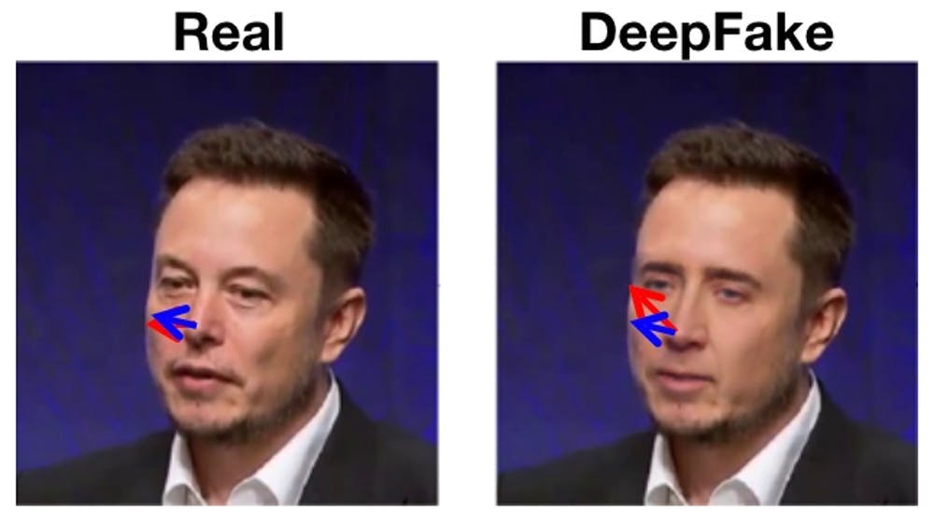

Slide 7
EXISTING SYSTEM
One major difference between traditional systems or techniques for deepfake detection and ConvNets2D is that ConvNets2D can be trained to automatically learn features from the data, whereas traditional systems rely on manual feature extraction.
Additionally, ConvNets2D are able to process images in a hierarchical manner, allowing for the detection of increasingly complex patterns as the image is processed through multiple layers.

Slide 8
PROPOSED SYSTEM
The proposed method advanced 2D convolutional neural networks. These networks are able to extract high-level features from the input data, which allows them to effectively classify deepfake faces based on these features.
The proposed method is evaluated on a large dataset of real and fake faces and the results indicate that it is able to achieve a high level of accuracy in detecting deepfake faces. Additionally, the system's ability to adapt to new and unseen deepfake techniques, makes it a more resilient and effective solution for detecting deepfake faces. The proposed method can help to mitigate the risks associated with the spread of false information and propaganda caused by deepfake technology.

Slide 9

FloWCHART

Slide 10
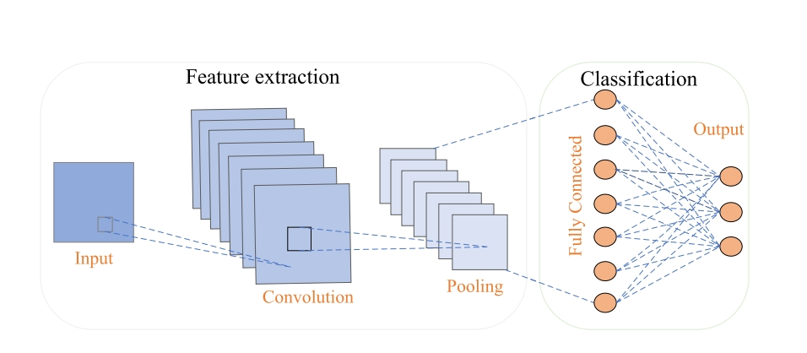
ARCHITECTURE OF CNN

Slide 11
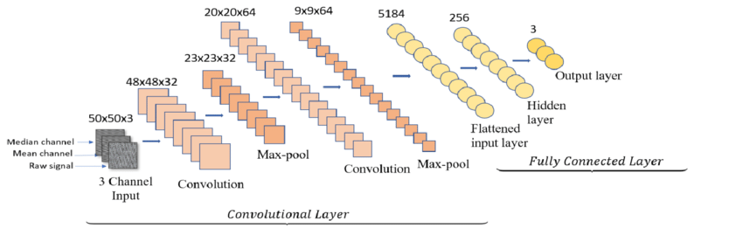
ARCHITECTURE OF 2D CNN

Slide 12
A convolutional layer is the main building block of a CNN. It contains a set of filters (or kernels), parameters of which are to be learned throughout the training. The size of the filters is usually smaller than the actual image. Each filter convolves with the image and creates an activation map.
The purpose of the pooling layers is to reduce the dimensions of the hidden layer by combining the outputs of neuron clusters at the previous layer into a single neuron in the next layer.
Flattening is used to convert all the resultant 2-Dimensional arrays from pooled feature maps into a single long continuous linear vector. The flattened matrix is fed as input to the fully connected layer to classify the image.

Slide 13
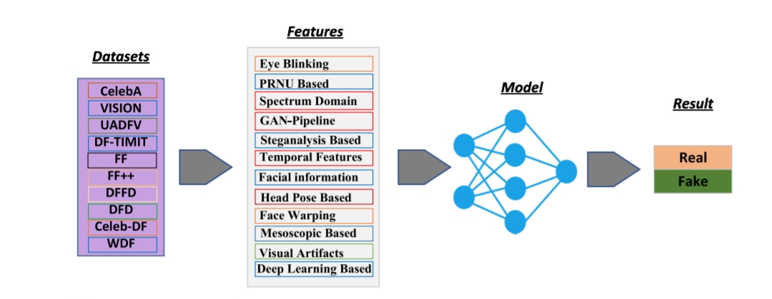

Slide 14
THANK YOU

